Slide 1

ADVANCED MACHINE LEARNING: FINAL PROJECT
RESEARCH PAPER ON THE CONCEPT
Deep Learning for Early Heart Attack Prediction: Methods, Studies, Uses, Tests, and Future Prospects

Slide 2


Deep Learning for Early Heart Attack Prediction
Methods, Studies, Uses, Tests, and Future Prospects
Vikram kumar Bonagiri | St ID: 811368127
Guidance by: Chaojiang (CJ) Wu, Ph.D.

Slide 3
The Critical Challenge
Heart attacks remain one of the world's most dangerous health threats. Many patients show early warning signs—subtle ECG changes, irregular heart rates, abnormal stress indicators—long before a major cardiac event occurs.
90%
The Problem: Traditional checkups often miss these warning signs, and both doctors and patients struggle to detect them without advanced tools.
Detection Accuracy
CNN models achieve 90-95% accuracy in identifying myocardial infarction
The Solution: Deep learning can automatically identify patterns in ECG signals, wearable sensor data, and clinical records that reveal danger before symptoms appear.
92%
LSTM Sensitivity
LSTM models detect dangerous heart rhythms with 92-97% sensitivity

Slide 4




Three Types of Cardiac Data
ECG Data
Wearable Sensor Data
Clinical Data
Electrical signals showing heart function through P-waves, QRS complexes, and T-waves
Continuous monitoring of heart rate, HRV, and activity levels from devices
Structured patient information including age, cholesterol, blood pressure, and symptoms

Slide 5
Deep Learning Model Architectures
01
02
Convolutional Neural Networks (CNNs)
Long Short-Term Memory (LSTMs)
Detect unique shapes and patterns in ECG waveforms automatically. Excel at identifying small, rapid changes in cardiac rhythms with 90-95% accuracy.
Understand sequences and long-term trends in heart data. Capture gradual changes in HRV over minutes or hours with 92-97% sensitivity.
03
04
Transformer Models
Multi-Layer Perceptrons (MLPs)
Use attention mechanisms to focus on critical signal portions. Outperform LSTMs by 3-5% on multi-lead ECG data with interpretable attention maps.
Process structured clinical data efficiently. Achieve 80-90% accuracy on tabular datasets with cholesterol, blood pressure, and symptom data.

Slide 6
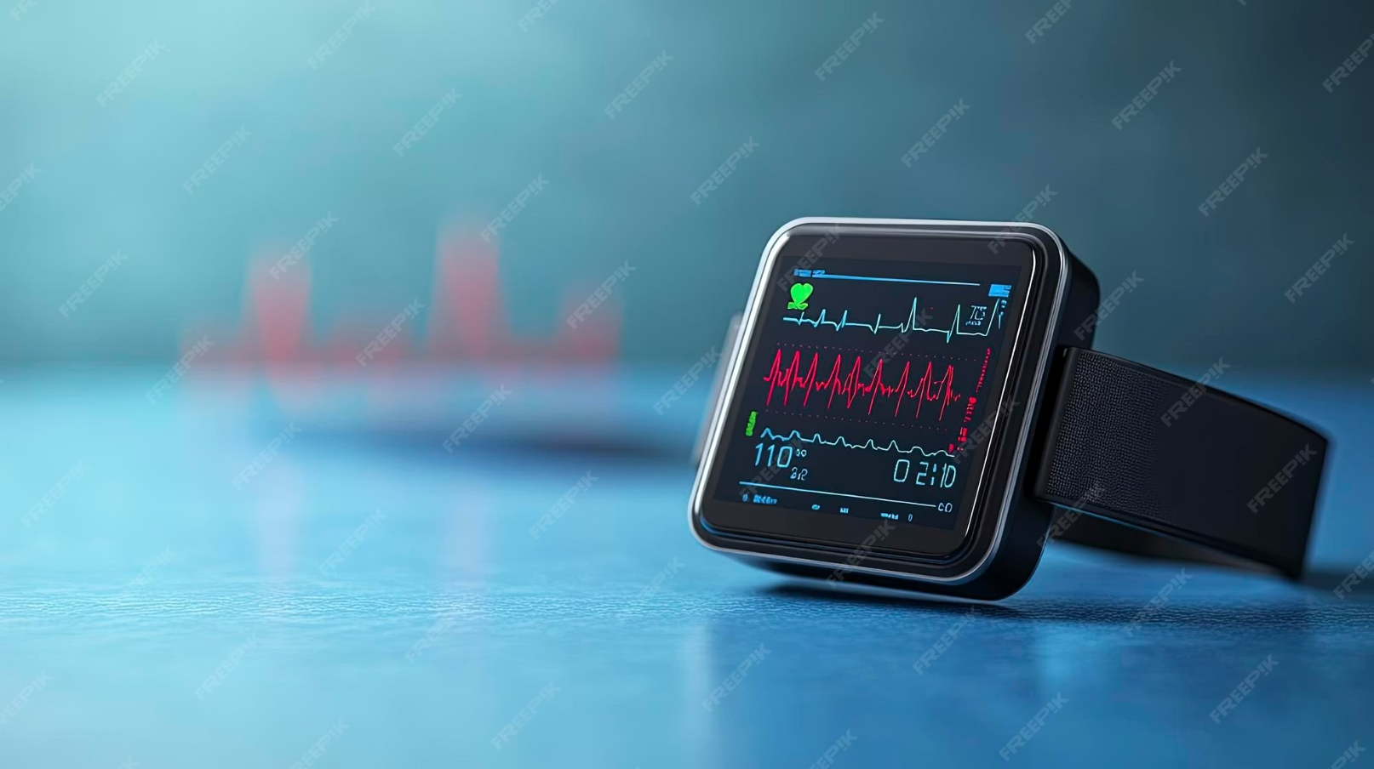
CNN Architecture Advantages
Why CNNs Excel for ECG Analysis
Automatically extract features without manual programming
Detect small, rapid changes in ECG rhythms
Work with both 1D signals and 2D medical images
Focus on crucial signal locations while reducing noise
CNNs identify P-waves, QRS complexes, and T-waves with exceptional precision, making them ideal for cardiac signal analysis.

Slide 7



Research Findings Across Data Types
ECG Dataset Studies
Wearable Technology Research
Clinical Data Analysis
Datasets: MIT-BIH, PTB-XL
Source: UCI Heart Disease dataset
Devices: Fitbit, Apple Watch, chest straps
CNN models achieve high accuracy in cardiac attack detection
MLP models predict heart disease with 80-90% accuracy
LSTM models detect stress early with >92% accuracy using HRV signals
Deep learning outperforms statistical models on non-linear patterns
CNN-LSTM hybrids improve sensitivity through combined pattern recognition
AI discovers atrial fibrillation hours before symptom onset
Combining clinical features with ECG enhances predictions
Transformers outperform LSTMs for long ECG recordings
Fewer false alarms than traditional methods

Slide 8
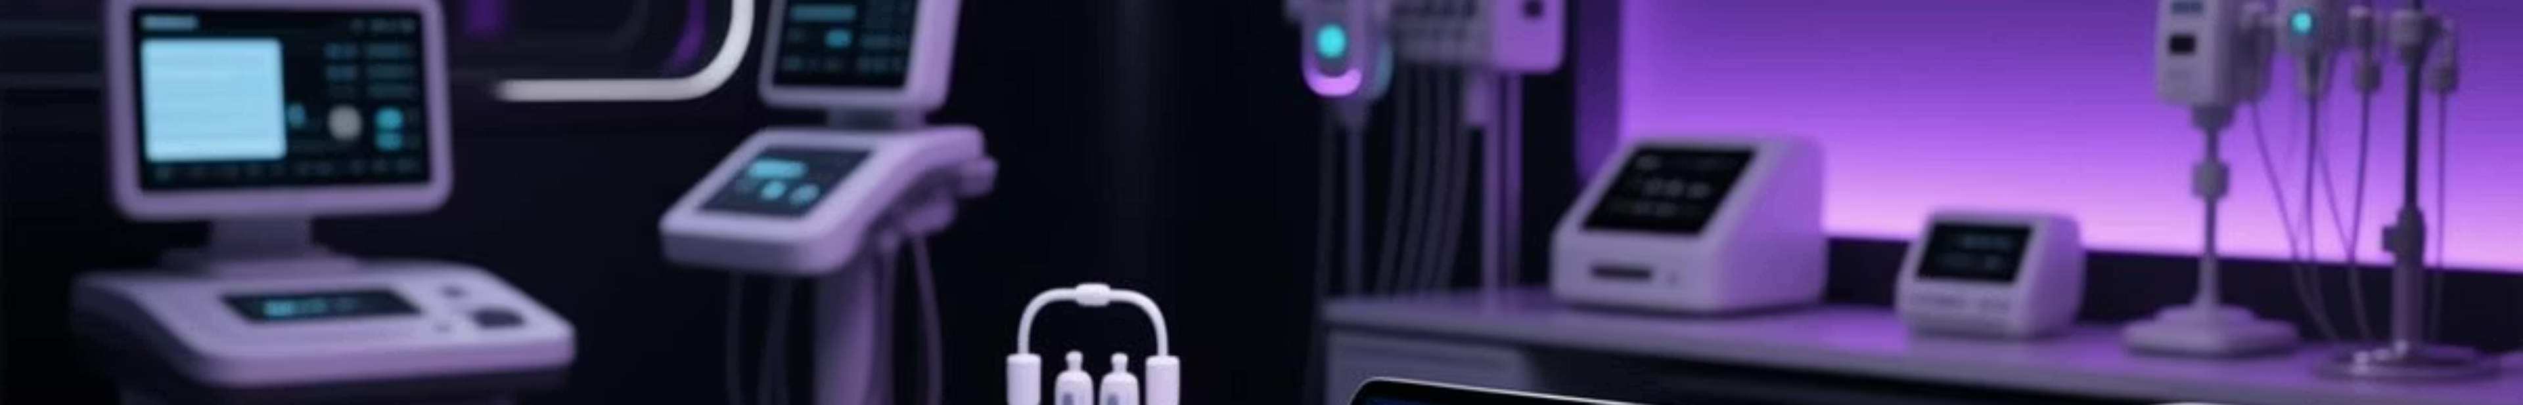




Real-World Applications
Hospitals & Emergency Services
Wearable Consumer Devices
Automatic ECG interpretation, early cardiac arrest detection, reduced ICU false alarms, and high-risk patient triage systems for faster emergency response.
Continuous heart monitoring with early warning alerts for atrial fibrillation and stress patterns. Personalized health insights enable preventive care.
Telemedicine & Remote Monitoring
Health Risk Assessment
Long-term ECG analysis from home devices reduces hospital visits. Better longitudinal analysis for elderly patients with easier healthcare access.
Insurance companies use AI for better risk understanding. Supports personalized health plans and prevention-focused premium structures.

Slide 9
Current Limitations & Challenges
Insufficient or Imbalanced Data
ECG Signal Variations
Lack of Interpretability
Different machines produce different-looking ECGs, making it harder for models to generalize across devices and settings.
Many deep learning models function as "black boxes." Doctors need clear explanations for predictions to trust AI recommendations.
Medical datasets often contain more negative cases than positive ones, making training difficult and potentially biasing models.
Privacy & Ethical Concerns
Real-Time Processing Issues
Medical information must remain protected. Strict regulations govern how large models can be trained on patient data.
Wearable devices may lack computational power to run large models independently, requiring cloud processing with latency concerns.

Slide 10



Future Directions in Cardiac AI
Federated Learning
Explainable AI (XAI)
Multimodal Deep Learning
Train shared models across hospitals without sharing actual patient data, preserving privacy while improving accuracy.
Clearer visual explanations make model results more trustworthy for clinical decision-making.
Combine ECG, blood tests, vital signs, and clinical history for superior predictions.
Pre-trained Medical Models
Lightweight AI for Wearables
Future AI trained on millions of ECGs will deliver better, more reliable predictions across diverse populations.
Smaller models running on watches and phones enable immediate alerts without cloud dependency.

Slide 11
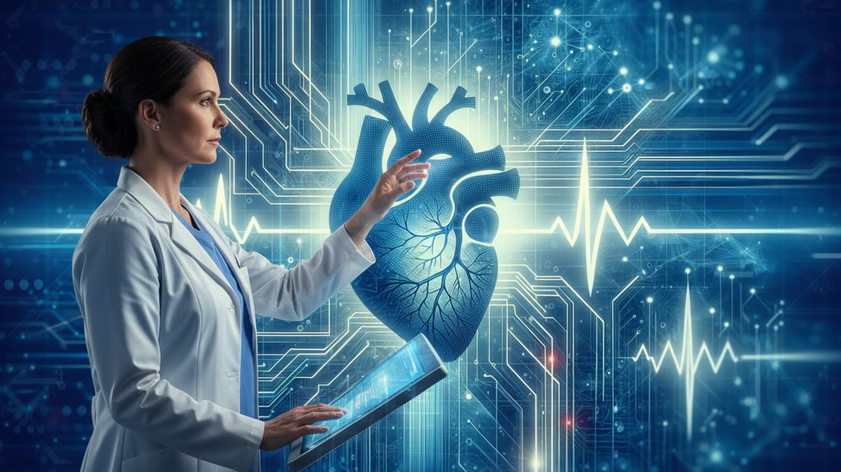
Conclusion: Transforming Cardiac Care
Deep learning is revolutionizing early heart attack prediction by analyzing patterns in ECG readings, wearable sensors, and clinical data long before symptoms appear.
Proven Success
The Path Forward
CNNs, LSTMs, and Transformers consistently outperform traditional manual interpretation with 90-97% accuracy across multiple studies.
While challenges remain—data imbalance, privacy concerns, interpretability—emerging technologies like federated learning, explainable AI, and multimodal models are making cardiac AI more reliable.
Real-world applications in hospitals, telemedicine, and wearable devices are already improving preventive care and reducing emergency situations.
As technology evolves, deep learning will dramatically improve early detection, assist physicians, and save lives through timely heart risk identification.

Slide 12
References:
Kiranyaz, S., Ince, T., & Gabbouj, M. (2016). Real-time patient-specific ECG classification by 1-D convolutional neural networks. IEEE Transactions on Biomedical Engineering, 63(3), 664–675. https://doi.org/10.1109/TBME.2015.2468589 PDF link: http://qufaculty.qu.edu.qa/mkiranyaz/wp-content/uploads/sites/572/2016/05/TBME2468589.pdf
Moody, G. B., & Mark, R. G. (2001). The impact of the MIT-BIH Arrhythmia Database. IEEE Engineering in Medicine and Biology Magazine, 20(3), 45–50.* PDF link: http://georgebmoody.com/publications/mitdb-embs-2001.pdf
Tison, G. H., Sanchez, J. M., Ballinger, B., Singh, A., Olgin, J. E., Pletcher, M. J., & Marcus, G. M. (2018). Passive detection of atrial fibrillation using a commercially available smartwatch. JAMA Cardiology, 3(5), 409–416.* https://jamanetwork.com/journals/jamacardiology/fullarticle/2675364
Kachuee, M., Fazeli, S., & Sarrafzadeh, M. (2018). ECG heartbeat classification: A deep transferable representation. arXiv Preprint arXiv:1805.00794. https://arxiv.org/abs/1805.00794
Hannun, A. Y., Rajpurkar, P., Haghpanahi, M., Tison, G. H., Bourn, C., Turakhia, M. P., & Ng, A. Y. (2019). Cardiologist-level arrhythmia detection and classification in ambulatory electrocardiograms using a deep neural network. Nature Medicine, 25(1), 65–69. https://www.nature.com/articles/s41591-018-0268-3

Slide 13
THANK YOU

